Slide 1
Intro to Superset API
Srini Kadamati

Slide 2
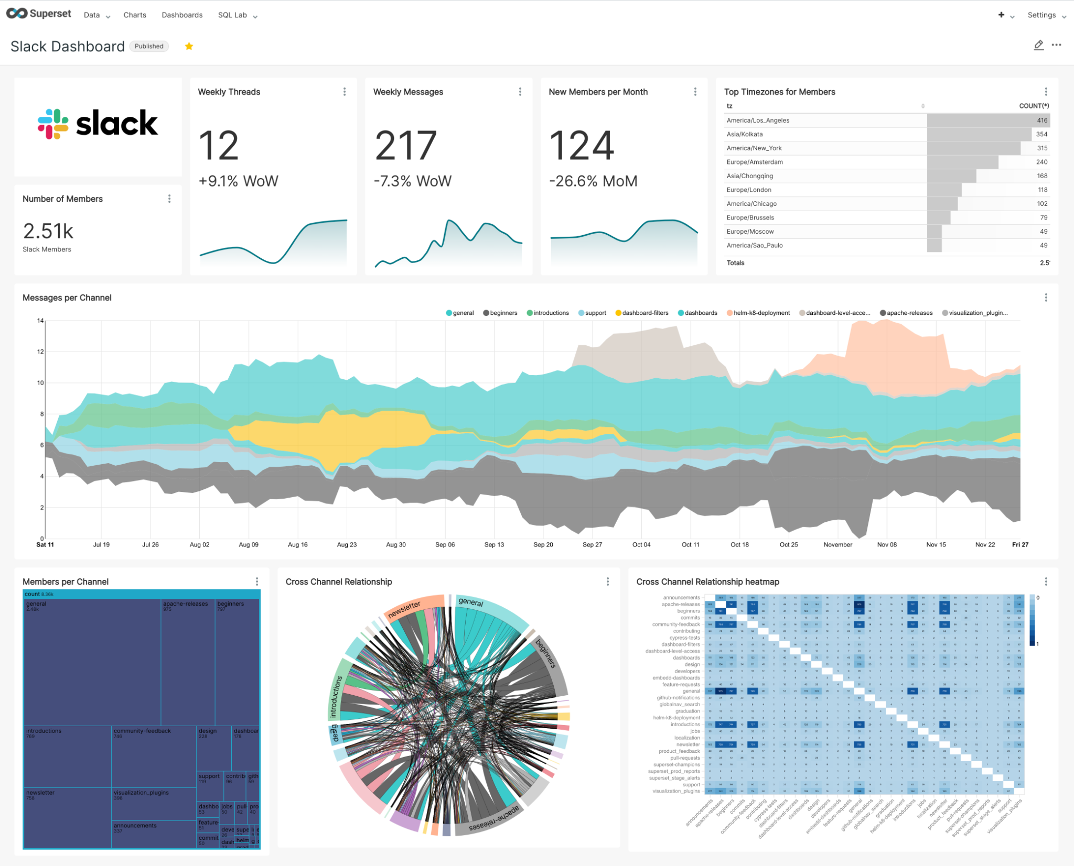
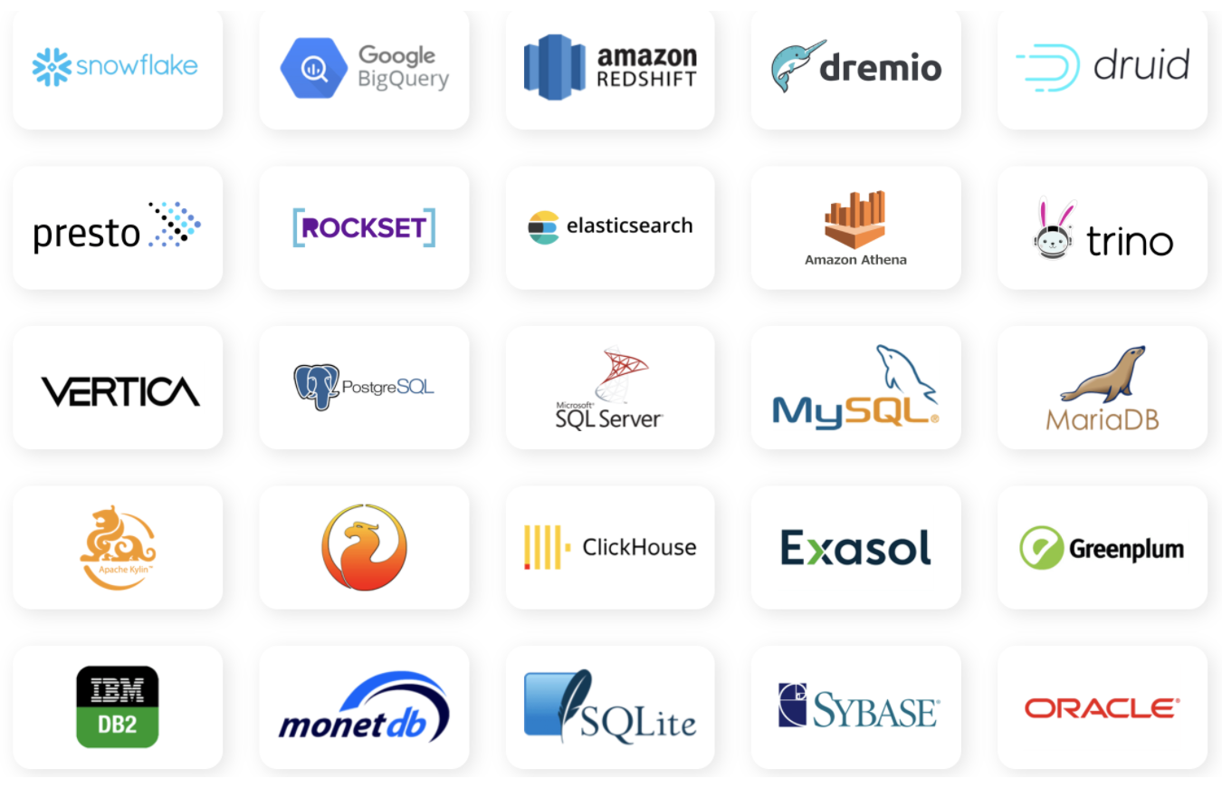
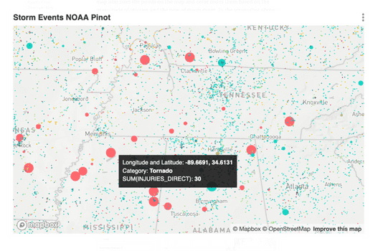
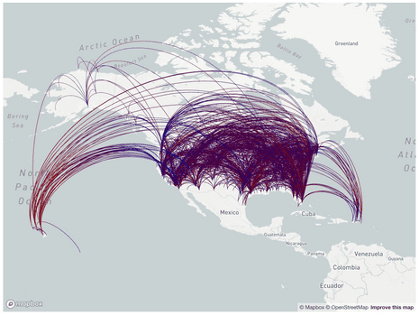
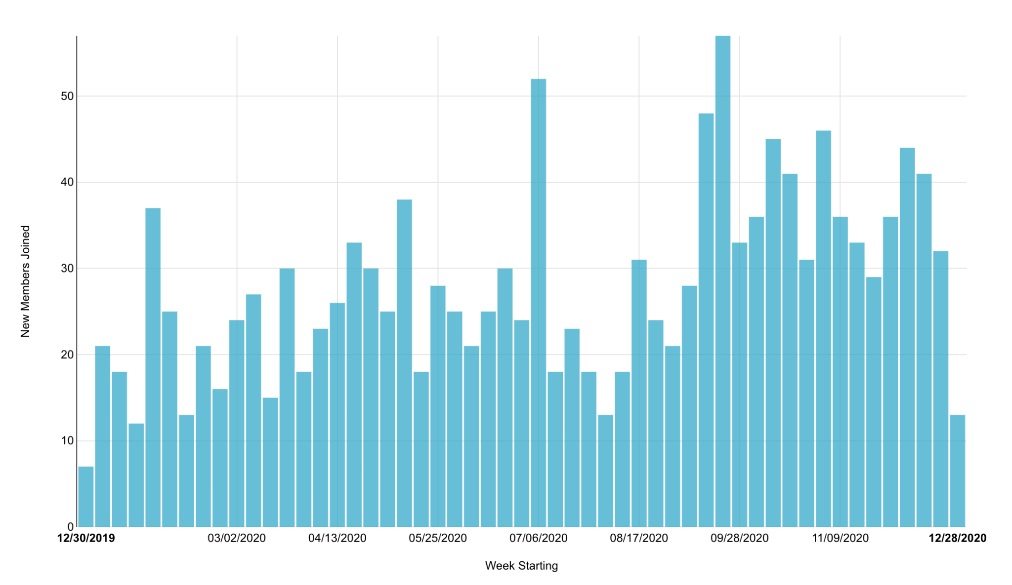
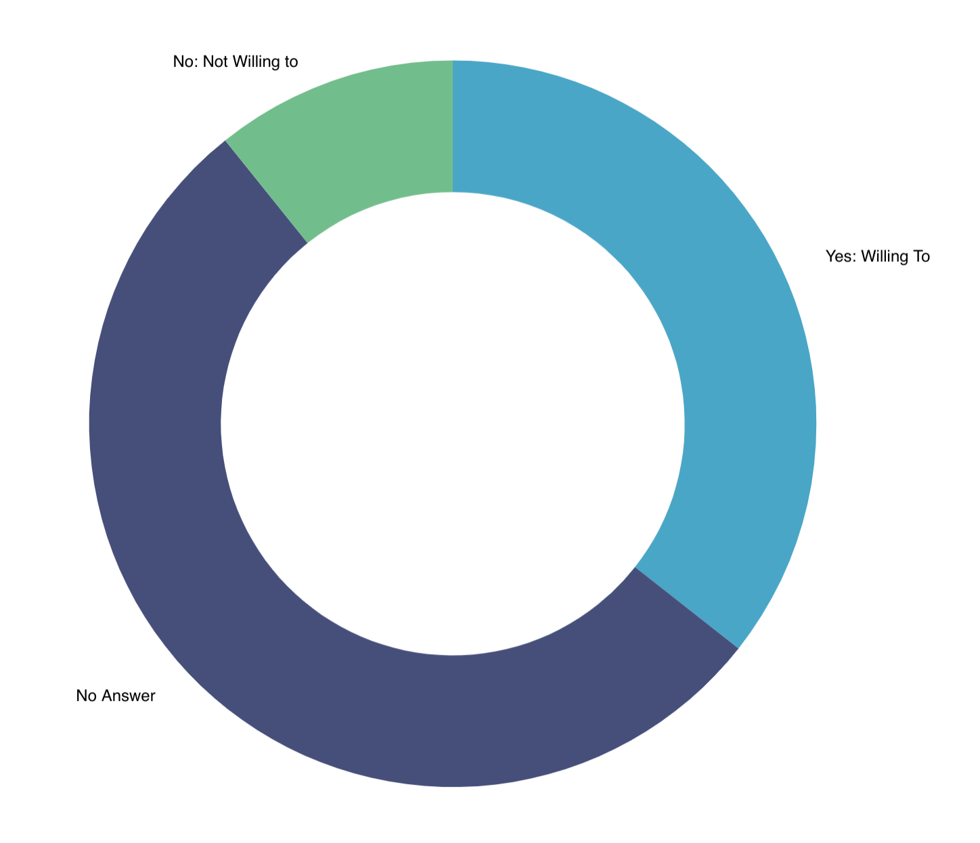
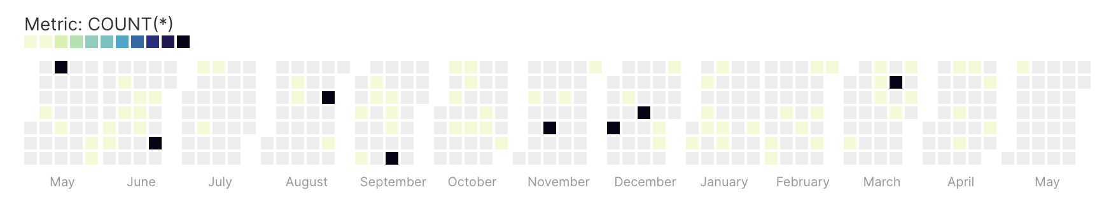
What is Apache Superset?
Works with nearly any SQL speaking data engine
Large diversity of charts
Modern open source BI platform
Notes:
Superset is a modern, open-source business intelligence platform that supports a large variety of visualizations and databases.

Slide 3
Tour of Superset Objects
Databases
Datasets
Saved Queries
SQL Lab
Charts
Dashboards
Annotation Layer
CSS Templates
Reports
Semantic Layer
Metrics
Calculated Columns
Virtual datasets
Jinja Filters
Alerts & Reports
Row Level Security
Logs
Saved Queries

Slide 4
Target Outcome
This event is focused on introducing the Superset API, targeted at:
Devops / Data / Full-stack Engineers new to Superset
Data Scientists / Data Analysts comfortable with APIs
Curious folks interested in what the API can do!

Slide 5
Superset API

Slide 6

North Star
Short - medium term
Make any end-user / GUI action available via the API
Longer term
Turn Superset into a data product platform!

Slide 7

Tech Specs
Follows OpenAPI specification and is RESTful
Built mostly using Flask App Builder
Interactive Swagger documentation lives at /swagger/v1 endpoint
Primarily interacts with the underlying data model / metadata layer in Superset
Supports RISON or JSON

Slide 8
API Use Cases
Invalidate cache upon data refresh
GET /chart/data{cache_key}
POST /cachekey/invalidate
Import, export dashboards
GET /dashboard/export
POST /dashboard/import
Create new database
POST /database/
Return SELECT * from a db table
GET /database/{pk}/select_star/{table_name}/
Schedule a new report
POST /report

Slide 9
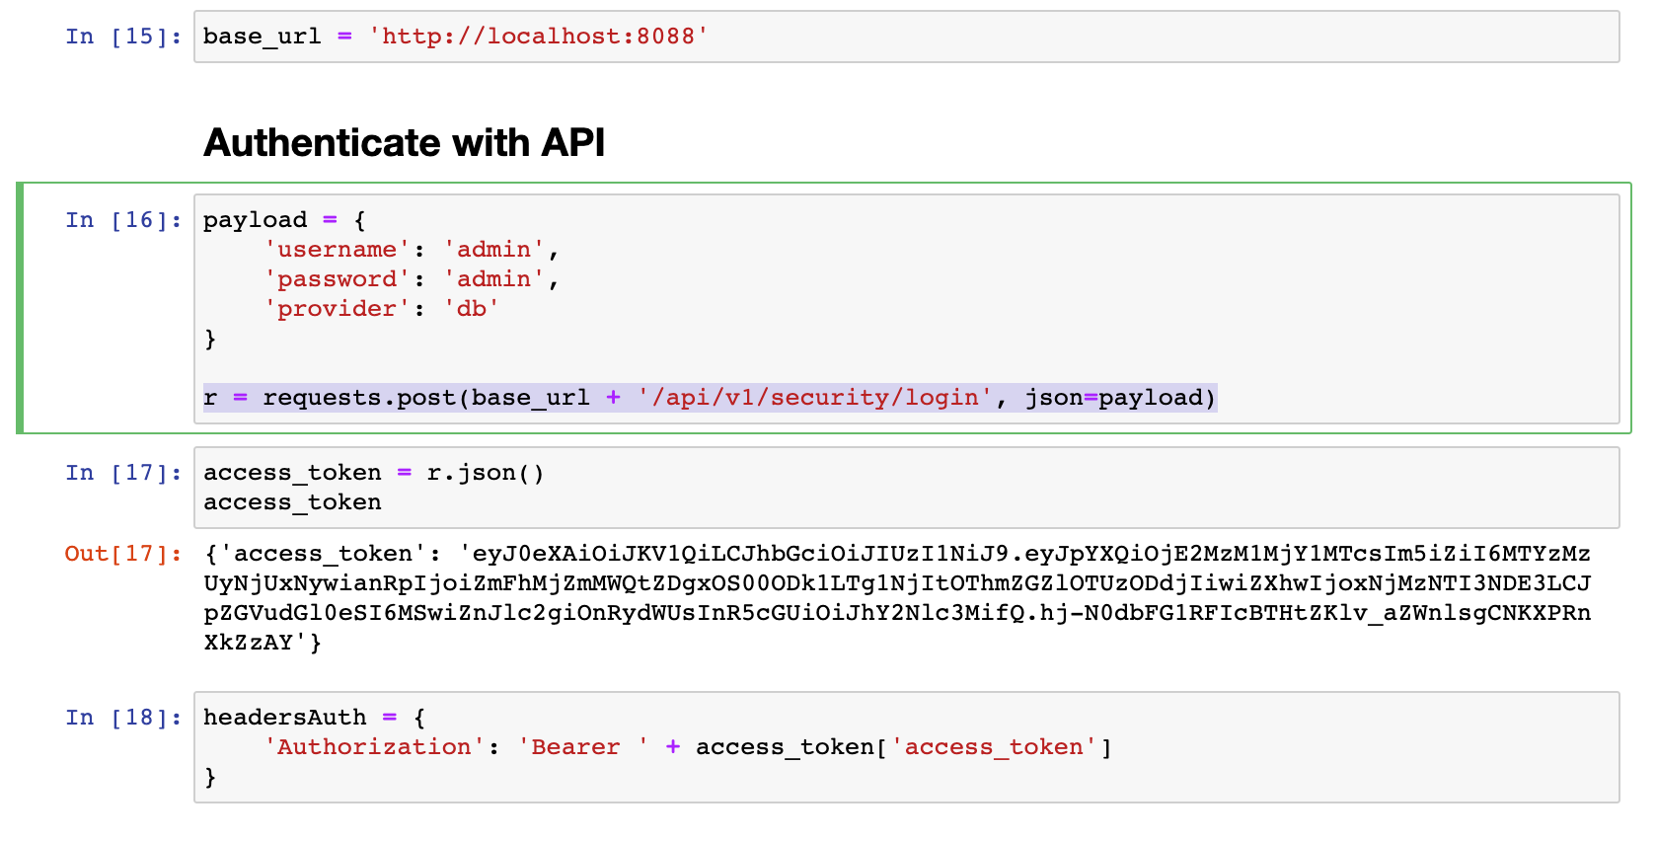
Authenticating with API

Slide 10
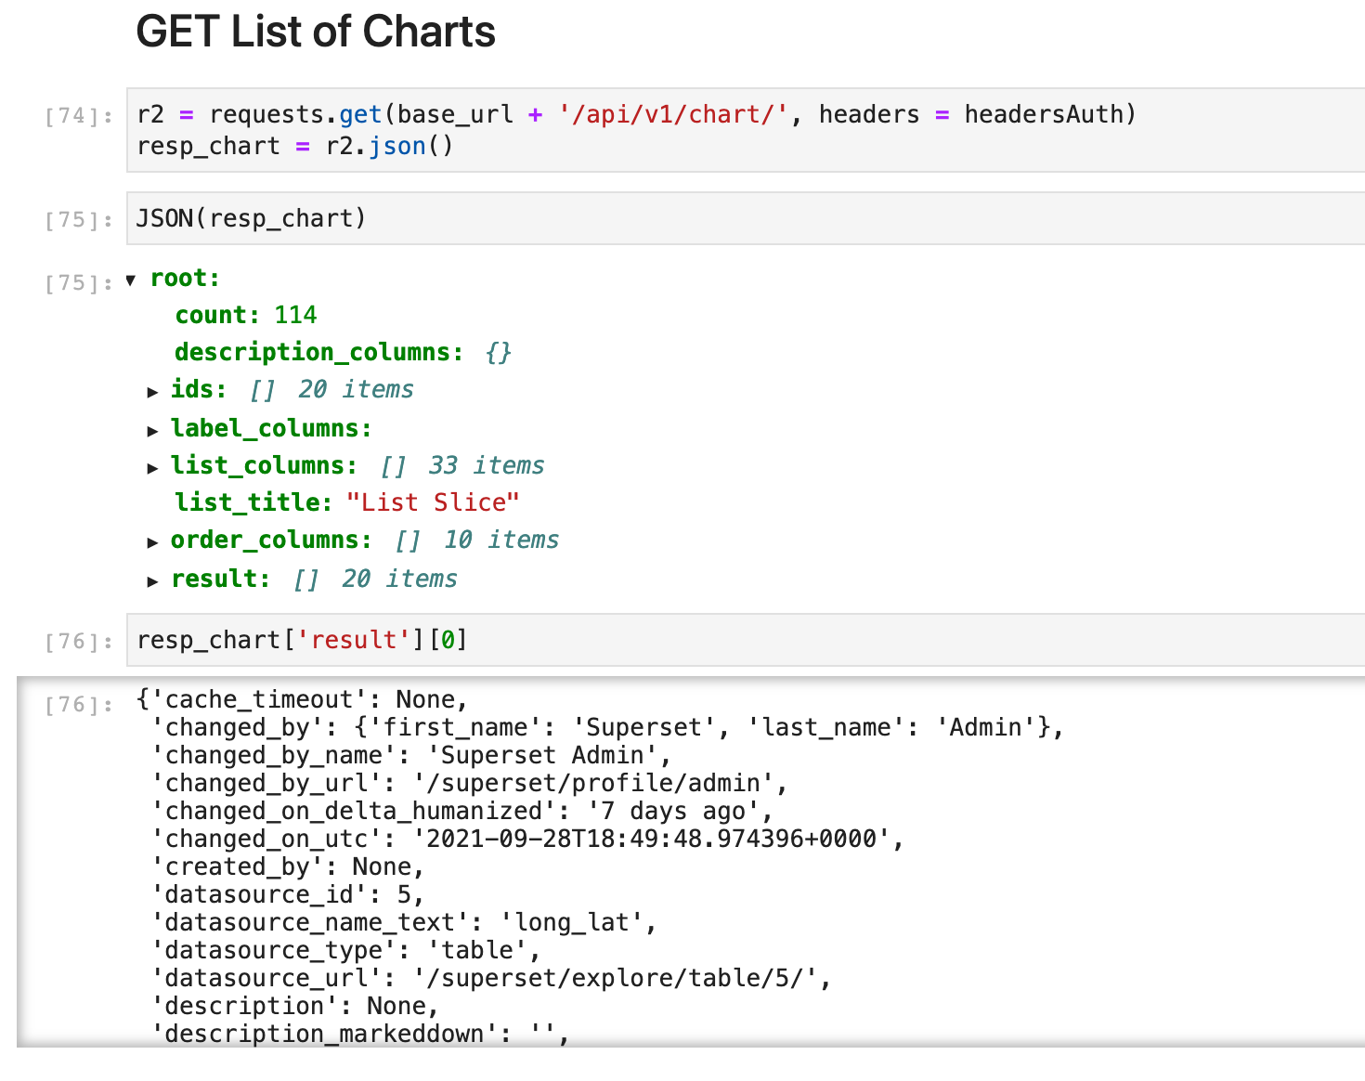
GET Some Things

Slide 11
Superset CLI
Superset CLI is very powerful and some things are only possible there
Beto Dealmeida opened a PR (#15686) to enable a CLI command for importing a dashboard:
superset import-directory -o ~/Downloads/dashboard_export_20210715T205336/

Slide 12
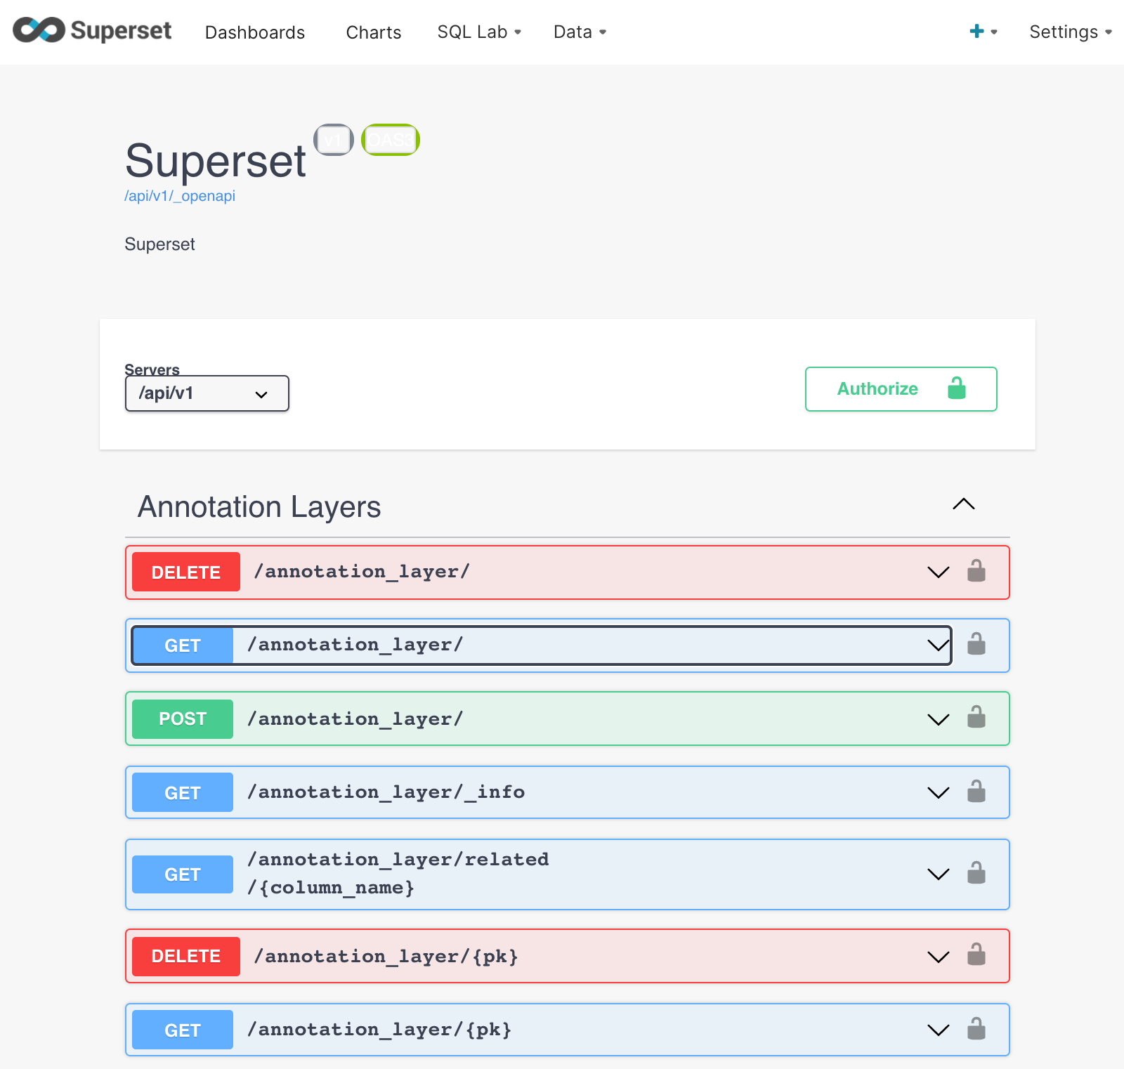
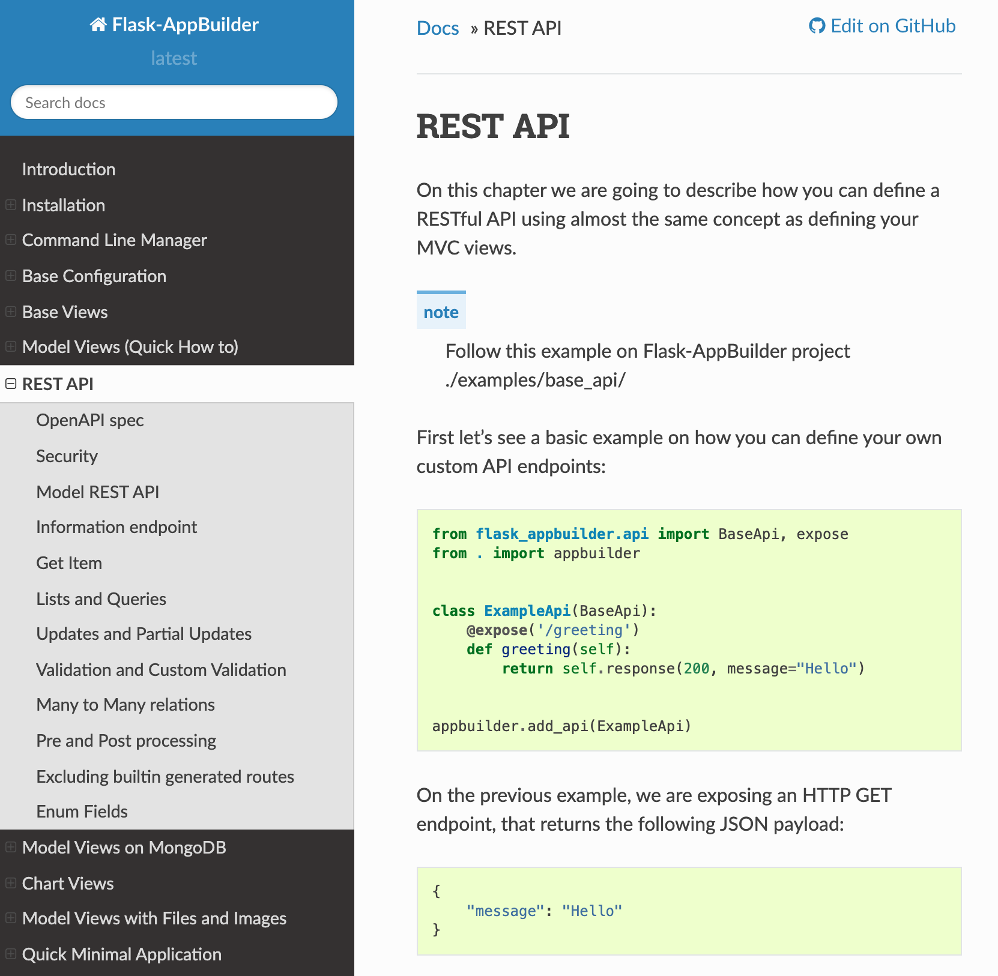
Documentation
https://superset.apache.org/docs/rest-api (or <your_superset_url>/swagger/v1
https://flask-appbuilder.readthedocs.io/en/latest/rest_api.html

